Slide 1


Bagging

Slide 2

Bagging
Bagging is an ensemble learning technique that aims to improve the stability and accuracy of machine learning algorithms by reducing variance and avoiding overfitting.
The word Bagging stands for Bootstrap Aggregating — It combines two main ideas:
1.Bootstrap Sampling (Random Sampling with Replacement)
2.Aggregation (Averaging or Voting)

Slide 3
How Does Bagging Work
1.Create Mulyiplr Datasets
From your original dataset, create multiple random samples with replacement (this means some data points may appear more than once in a sample).
Each sample is called a Bootstrap Sample.
2. Train Separate Models on Each Sample
On each sample, train a separate model (for example, Decision Trees).
Each model is different because it’s trained on slightly different data.
3. Make Predictions with All Models
When predicting, all models give their outputs.
For classification, take a majority vote.
For regression, take the average.

Slide 4
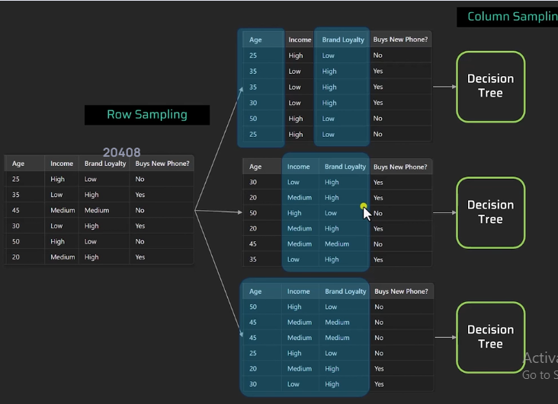

Slide 5
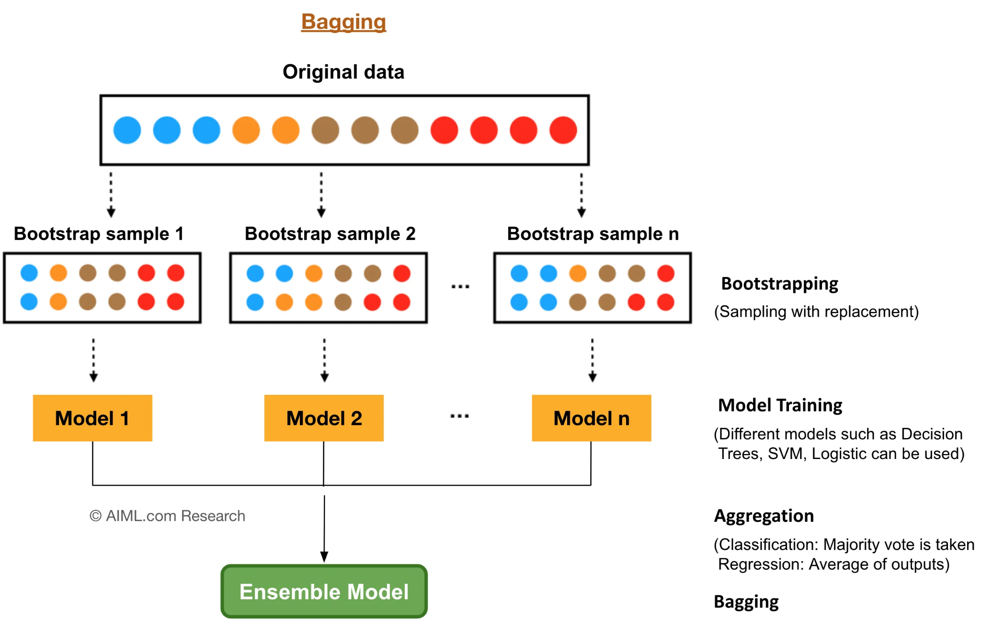

Slide 6
BOOSTING

Slide 7
AdaBoosting
AdaBoost (Adaptive Boosting) is an ensemble learning technique that combines multiple weak classifiers to create a strong classifier.
It focuses on training weak learners sequentially, giving more weight to misclassified instances so that subsequent models perform better on those samples.

Slide 8
How Does AdaBoost Work
Initialize all sample weights equally.
Train a weak learner (e.g., a shallow Decision Tree) on the data.
Increase weights of misclassified samples to make them more important.
Train the next weak learner using updated weights.
Combine all weak learners using weighted majority voting.
Continue until a specified number of learners (n_estimators) is reached.

Slide 9
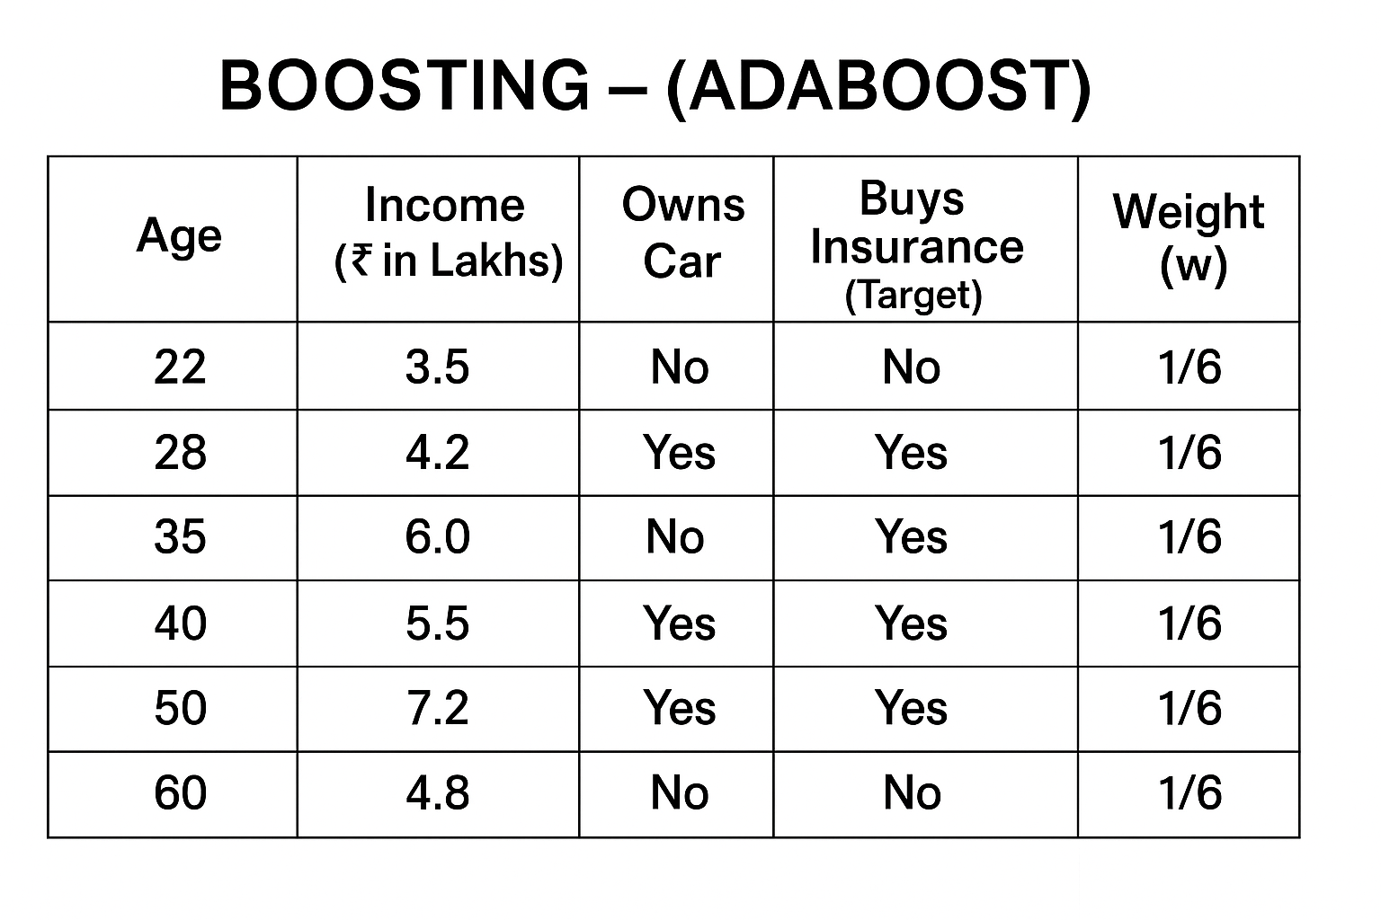

Slide 10
